Slide 1
Azure Administration

Slide 2







Cloud Computing
On demand access over the internet
Capex vs Opex
IT infra beyond boundaries – Scalability
Pay As You Go Model
Dependencies are taken care of
Better Security
Flexibility
Access from Anywhere – Global Infrastructure
High Availability
Quick to market
One Stop Solution
Different services in one place
Cost Effective Solution
Quick Infra Readiness

Slide 3
Cloud Computing
IaaS
PaaS
SaaS

Slide 4
Azure
Cloud offering from Microsoft
Azure Portal - Portal.azure.com

Slide 5
Azure Portal
Lets you build, manage and monitor everything from simple web apps to complex cloud applications in a single unified console
Search resources, service and docs
Manage resource
Create dashboards, favorites
Access the Cloud Shell
Receive Notifications
Links to Azure documentation

Slide 6
Azure Portal
Azure Portal lets you build, manage and monitor everything from simple web apps to more complex cloud application in a single, unified console
Search resources, service and docs
Manage resources
Access the cloud shell
Receive notifications
Links to Azure documentation

Slide 7
Azure Mobile App
Help you keep track of your resources while on-the-go
Stay connected to the cloud and check status and critical metrics
Diagnose and fix issues quickly
Run commands to manage Azure resources

Slide 8
Azure Cloud Shell
Interactive, browser-accessible shell for managing Azure resources.
Bash and Powershell

Slide 9
Azure PowerShell
https://learn.microsoft.com/en-in/powershell/azure/install-azure-powershell?view=azps-10.3.0
https://learn.microsoft.com/en-in/powershell/module/az.accounts/?view=azps-10.3.0#accounts

Slide 10
Azure CLI
https://learn.microsoft.com/en-in/cli/azure/install-azure-cli
https://learn.microsoft.com/en-in/cli/azure/reference-index?view=azure-cli-latest

Slide 11
Resource Manager

Slide 12
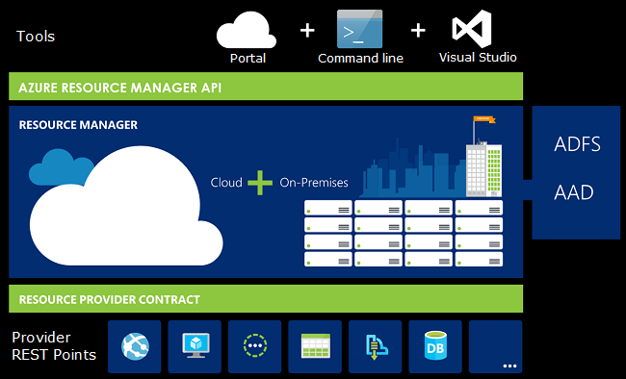
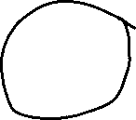













Resource Manager

Slide 13
Terminologies
Resource – A manageable item that is available through Azure Ex: VM, Storage, Web App, Storage Account
Resource Group – A container that holds related resources for an Azure solution.
Resource Provider – A service that supplies the resources you can deploy and managed through Resource Manager. Ex: VM – Microsoft.Compute, Web Apps – Microsoft.Web, Storage Account - Microsoft.Storage

Slide 14
Resource Group
Logical collection of resources
Resources can only exist in one resource group
Resource groups cannot be renamed
Resource groups can have resources of different types
Resource groups can have resources from many different regions

Slide 15




























Slide 16
Resource Group
Create
Lock Resources
Move Resources
Delete

Slide 17
Resource Manager Locks
Allows you to put up a structure in place that prevents accidental deletion of resource
Two Types
Read-Only Lock – Prevents any changes to the resource
Delete Lock – Prevent deletion
Owner and User Access Administrator roles can create or delete management locks.

Slide 18
Moving Resources
When moving resources, both the source group and target group are locked during the operation
https://learn.microsoft.com/en-us/azure/azure-resource-manager/management/move-support-resources

Slide 19
Resource Group Deletion
Be cautious when deleting resource group as every single thing in the resource group will get deleted and there is no way to recover it

